Slide 1
Biodiversity
Analysis of biodiversity in national parks
Author: Mariana Mytiliños
Last updated: March 19, 2022
Analyzing Data with Python Capstone Project - Codecademy

Slide 2
Table of Contents
Species in the national parks
Analysis of endangerment status between different categories of species
Recommendations for conservationists
Sample size determination for the foot and mouth disease study
Appendix

Slide 3
Species
description

Slide 4
Species
5824 species in total.
7 categories of species: Mammal (3.67%), Bird (8.95%), Reptile (1.36%), Amphibian (1.37%), Fish (2.18%), Vascular Plant (5.72%), Nonvascular Plant (76.75%).
96.72% of the species don’t require conservation efforts, while 2.76% are species of concern.

Slide 5
Endangerment status analysis

Slide 6
Endangerment status
3.28% of species are protected.
Protected species by category: Mammal (17.05%), Bird (15.37%), Reptile (6.41%), Amphibian (8.86%), Fish (8.73%), Vascular Plant (1.08%), Nonvascular Plant (1.5%).

Slide 7
A significance test for the endangerment status between different categories of species was performed.
Test method used: Chi Square test*
Mammals vs birds: The difference in endangerment is not significant**
Mammals vs reptiles: The difference in endangerment is significant***
* Performed in Python using the chi2_contingency function from scipy.stats
** (0.69 > 0.05) *** (0.04 < 0.05)

Slide 8
Recommendations for conservationists

Slide 9
Recommendations for conservationists
Overall, focus conservation efforts on mammals and birds, which are the species that require the most protection (17.05% and 15.37%, respectively)
Overall, vascular plants, nonvascular plants and reptiles are the species that require the least protection (1.08%, 1.5% and 6.41%, respectively)
Endangered species: Focus conservation efforts on mammals and fish, which are the categories with the highest % of endangered species (3.41% and 2.38%, respectively)
Threatened species: Focus conservation efforts on fish and amphibians, which are the categories with the highest % of threatened species (3.17% and 2.53%, respectively)
Species of concern: Focus conservation efforts on birds, mammals and reptiles, which are the categories with the highest % of species of concern (13.93%, 12.5% and 6.41%, respectively)

Slide 10
Sample size determination for disease study

Slide 11
Foot and mouth disease reduction program study
15% of sheep at Bryce National Park have foot and mouth disease
Detect reductions of at least 5%
Statistical significance: 90%
Sample size for the study is 39000 sheep *
Weeks of observation required by park:
Bryce National Park: 156 weeks
Yellowstone National Park: 77 weeks
Great Smoky Mountains National Park: 262 weeks
Yosemite National Park: 139 weeks
*determined by using Codecademy’s sample size calculator

Slide 12
Appendix
Data visualization

Slide 13
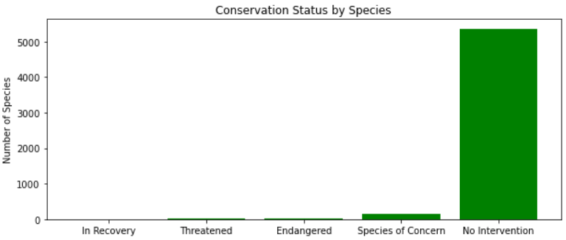
Conservation status by number of species. Source: Self-elaboration (Python).

Slide 14
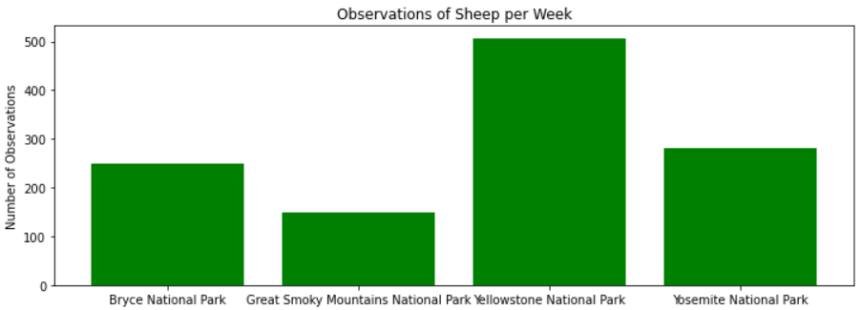
Observations of sheep per week by national park. Source: Self-elaboration (Python).

Slide 15
Thank you.

